Slide 1

Mobile Communications and Orchestration
Part 2/2 – introduction to the internet of things
University of western Macedonia
Christos Dalamagkas – cdalamagkas@uowm.gr
Prof. Panagiotis sarigiannidis – psarigiannidis@uowm.gr

Slide 2
Outline
Introduction to SDN
SDN architecture
Southbound protocols (CPSI / MPSI)
SDN controllers and SDN switches
Introduction to NFV
NFV architecture
SDN vs NFV
Orchestration
SDN/NFV-enabled 5G management
SDN Controller Demo

Slide 3
Traditional router architecture
Data plane
Holds the Forwarding Information Base (FIB) and Adjacency Tables – Mirrors of the control plane
NAT (Network Address Translation) and ACL (Access Control List) for low-level decisions
Takes place in ASICs (Application-specific integrated circuits)
Control Plane
Takes place in CPU
Routing protocols that build the Global Routing Table
ARP, MPLS and other protocols that manipulate FIB and Adjacency Table
Management Plane
Command Line Interface
Secure Shell
Vendor APIs (e.g. Aruba REST API) and management protocols (SNMP, NETCONF/RESTCONF etc)
Each device comes with a complete/independent implementation of all layers
This causes scalability and flexibility issues

Slide 4
SDN Architecture
Software-Defined Networking changes radically the traditional architecture by decoupling the architectural planes:
Control plane has been decoupled – can run on a server as a VM
The control plane can be written from scratch
Decoupled Control Plane = SDN Controller
The Control Plane can instruct the Data Plane what to do with each incoming or outcoming frame
Source: Cisco Networking Academy

Slide 5
SDN Architecture
Three Main Layers:
Data Plane (DP): Where packet forwarding is implemented, holding the forwarding tables (or flow tables)
Control Plane (CP): Manipulation of forwarding tables, Routing protocols, drawing of network topology
Application Plane: Applications implementing business logic
Control plane provides basic network functions, whereas application plane utilises abstracted APIs of the control plane to implement business logic
Management Plane is vertical and provides configuration management to CP and DP (e.g. SSH or monitoring via SNMP etc
Source: Cisco Networking Academy

Slide 6
SDN APIs
Planes are communicating using dedicated open APIs
Southbound API: Communication between Control Plane and Data Plane
Control Plane – Southbound Interface (CPSI): Directly manipulates the data plane and the forwarding plane
OpenFlow
Management Plane – Southbound Interface (MPSI): Applies configuration management to the network elements
NETCONF/RESTCONF
SNMP
Northbound APIs (NBIs): Third-party applications use NBI to communicate with the Control Plane
Non standardised REST APIs over HTTP

Slide 7

OpenFlow
The dominant CPSI protocol – Version 1.3 is the most widely implemented version
OpenFlow standard is developed by the Open Networking Foundation (ONF)
SDN switches (almost) replace routers and legacy switches
Forwarding is done per flow
Flow = A set of specific matching fields and actions, defined by the SDN Controller
Flow rule is a matching condition, based on fields of the incoming packet
Matching can be up to TCP/IP Layer 4 fields
Each role has an action – what is being done after matching
Common actions are DROP or OUTPUT (forward) to a specific port
QoS and security policies can be enforced per flow
OpenFlow enables flow-based communication in datacentres and 5G networks

Slide 8
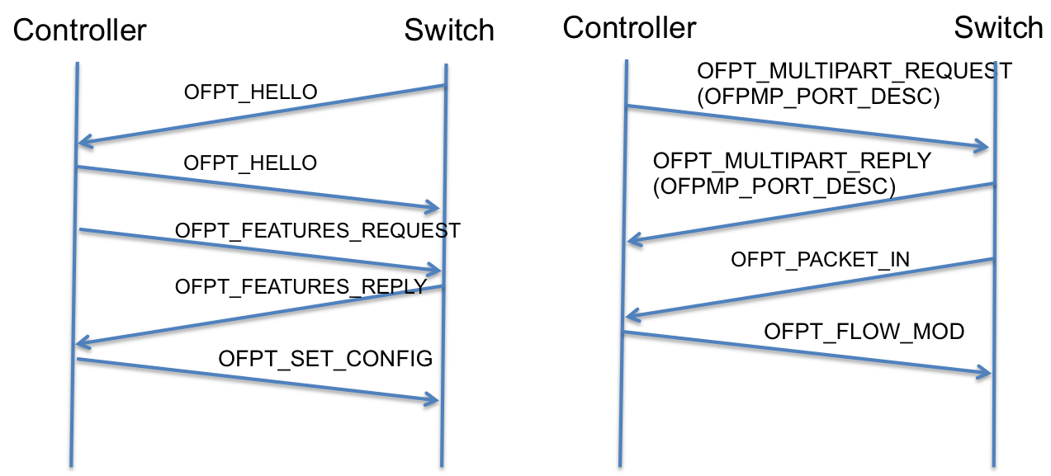
OpenFlow
Basic OpenFlow messages:
OFPT_HELLO is a message to initiate an OpenFlow session
OFPT_FEATURES_REQUEST is used to retrieve basic switch features (e.g. number of tables, buffers)
OFPT_MULTIPART_REQUEST is used to send one or more requests about switch information
OFPMP_PORT_DESC provides information about switch ports
OFPMP_TABLE_FEATURES provides information about existing tables and capabilities of each one
OFPT_PACKET_IN encapsulates an ingress packet that the switch does not know how to handle. The switch can read the packet and decide the appropriate action
OFPT_FLOW_MOD is a command message that inserts or modifies a network flow
OFPT_PACKET_OUT encapsulates a complete packet that the controller wants the switch to forward
OpenFlow Session Establishment
and Normal Operation

Slide 9
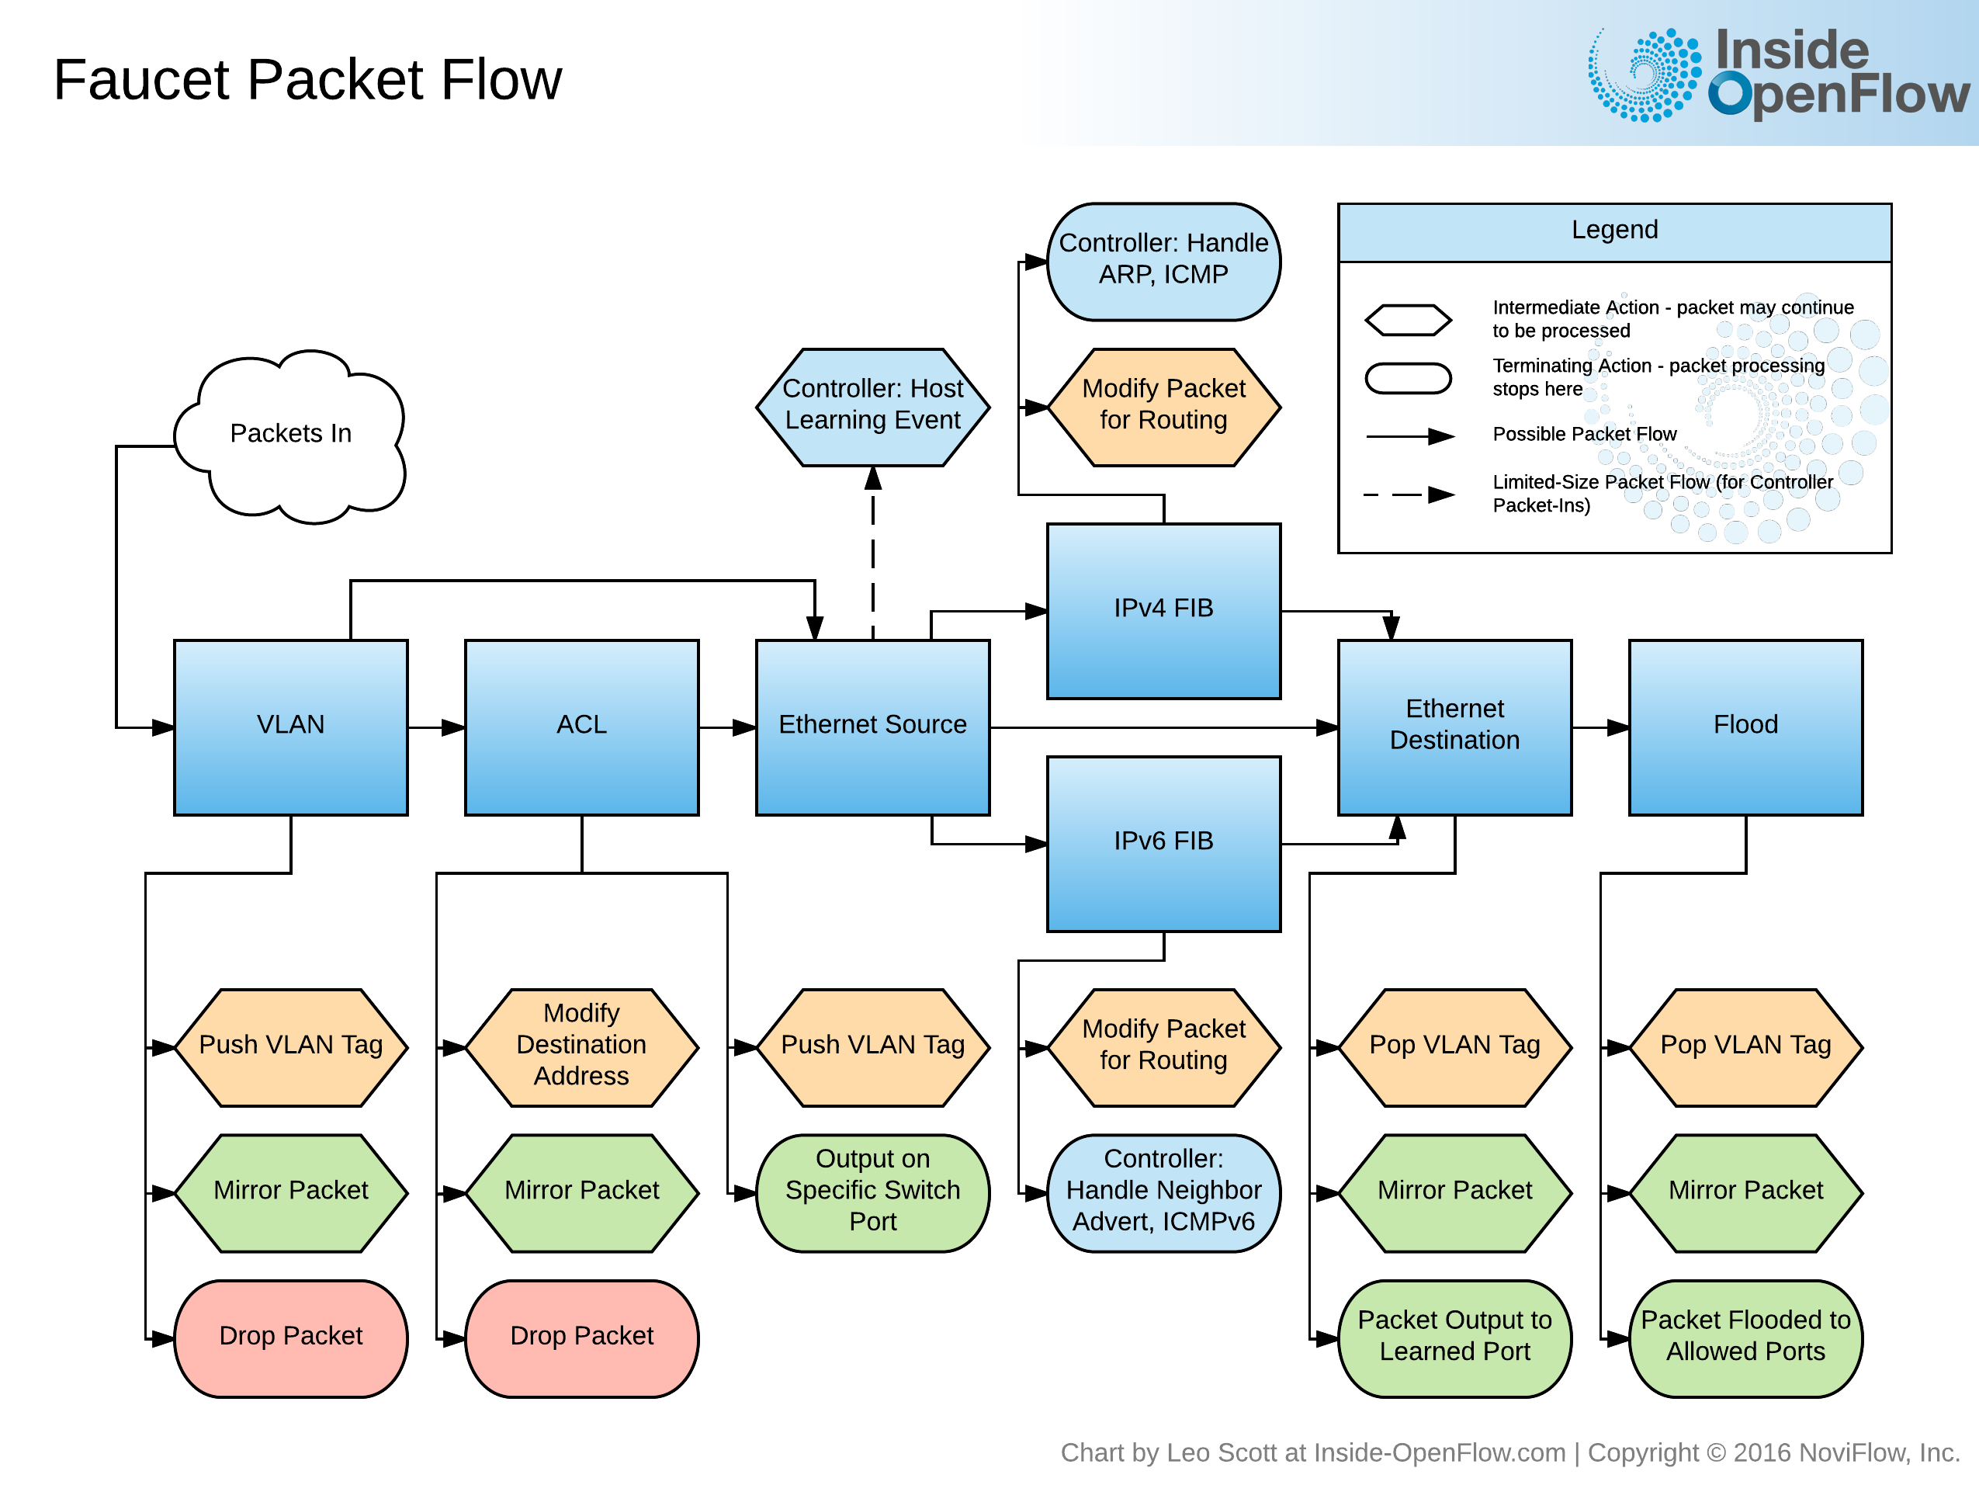
Custom Pipelines with OpenFlow
OpenFlow allow us to define complex pipelines to accelerate table lookups
Multiple tables can be created on the SDN switch programmable hardware, using OpenFlow
TCAMs: Can match specific fields in any TCP/IP layer
HASH: Matches a group of fields in L2
Depending on the defined capabilities of a table (matchable fields, max number of flow entries), consumes the corresponding resources
TCAM = Ternary Content-Addressable Memory
https://inside-openflow.com/2016/09/16/dissecting-faucet-pipeline/

Slide 10
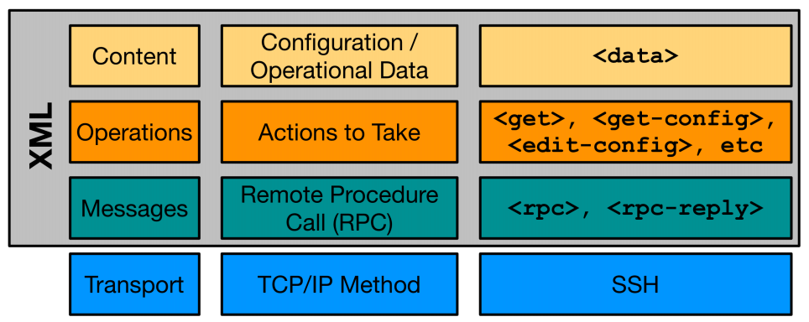
NETCONF
Provides interface to install, manipulate and delete configurations on network devices (MSPI protocol)
Published in 2011 as RFC6241 - Information is structured according to the YANG data model and communication is based on RPCs over a secure protocol
4 Conceptual Layers, depicted bellow
Content Layer: Includes the payload of a query or a command. The validity of this layer is subject to the YANG standard.
Operations Layer: Determines the type of query or action performed by NETCONF (get, get-config, edit-config, copy-config, delete-config, lock, unlock, close-session, kill-session)
Messages: Type of NETCONF message (client rpc, rpc-reply or hello message)
Secure Transport: Defines the secure protocol over which NETCONF msgs are transmitted (SSH, TLS, HTTPS)
https://www.cbtnuggets.com/blog/certifications/cisco/ccnp-enterprise-what-are-yang-netconf-restconf

Slide 11
NETCONF Operations
Operation | Description
<get> | Retrieve running configuration and device state information
<get-config> | Retrieve all or part of specified configuration data store
<edit-config> | Loads all or part of a configuration to the specified configuration data store
<copy-config> | Replace an entire configuration data store with another
<delete-config> | Delete a configuration data store
<commit> | Copy candidate data store to running data store
<lock> / <unlock> | Lock or unlock the entire configuration data store system
<close-session> | Graceful termination of NETCONF session
<kill-session> | Forced termination of NETCONF session

Slide 12
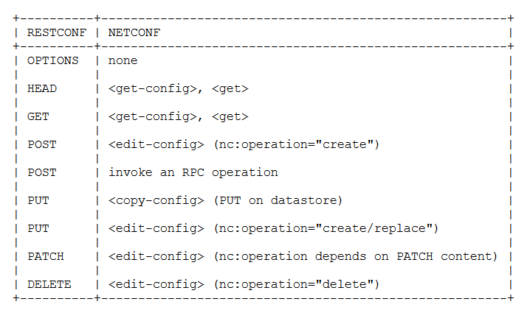
RESTCONF
HTTP-based configuration protocol, supporting both JSON and XML – Based too on YANG
Defined by RFC8040
RESTCONF is NOT a replacement of NETCONF – Provides a RESTful HTTP interface utilised to query and configure devices with NETCONF configuration datastores
Often used with Python and Requests library for automation/programmability tasks

Slide 13
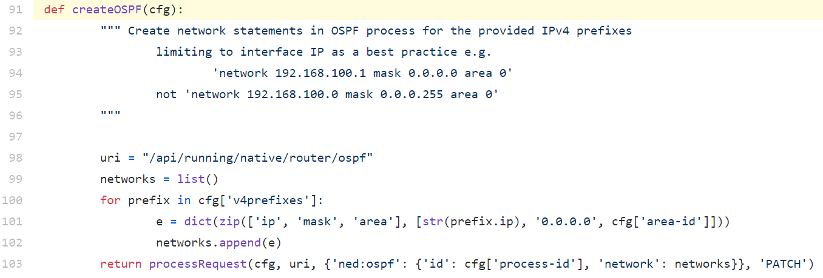
RESTCONF Example
https://github.com/CiscoDevNet/restconf-examples/blob/master/restconf-samplecode/vlans/xe-vlan.py#L102

Slide 14
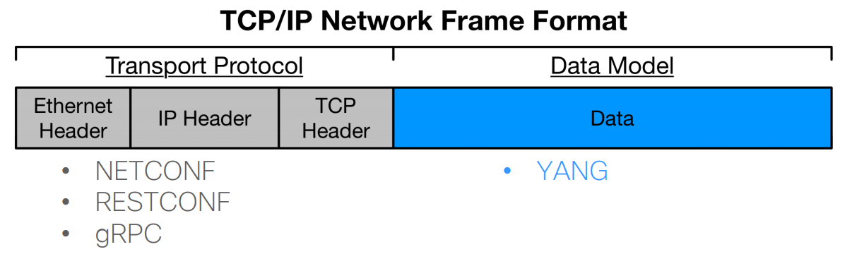
YANG – Yet Another Next Generation
Unlike JSON and XML, YANG is a data modelling language → Defines the data schemas that formats like XML and JSON should follow
What is data model? → The attributes that an item should have. E.g. what are the attributes of an Ethernet interface?
Configuration protocols like NETCONF and RESTCONF use data schemas based on YANG
Defined in RFC6020 – Common data types are defined in RFC 6991
https://www.netacad.com/sites/default/files/images/careers/Webinars/DevNet/devnet_session_7_networkprogrammability_yang_netconf_restconf.pdf

Slide 15

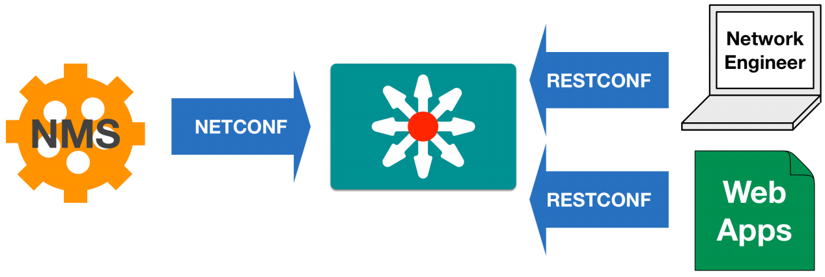
NETCONF vs RESTCONF
NMS = Network Management System

Slide 16







SDN Controllers
SDN Controller undertake flow control for improved network management and performance
SDN Controllers utilize CPSIs to interact with network devices (e.g. OpenFlow)
Most of them are Python or JAVA based
Ryu SDN Framework
Faucet

Slide 17
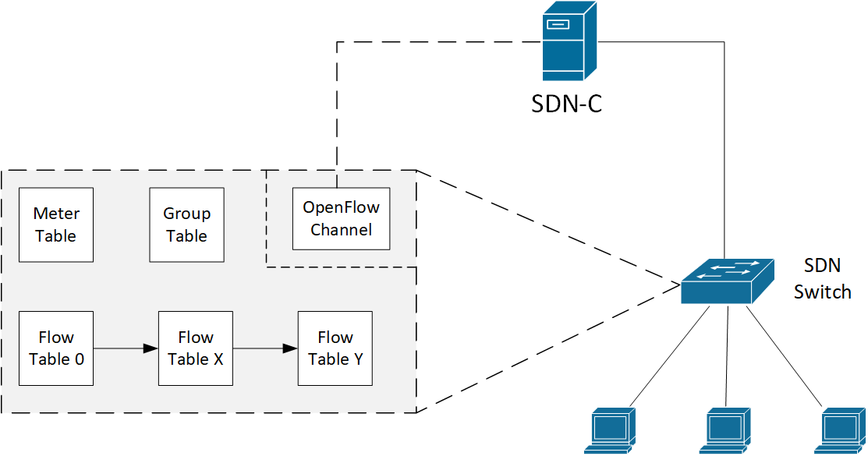
SDN Switches
A switch controlled by and OpenFlow SDN Controller includes the following structures:
Flow tables: Store rules that match incoming frames based on specific criteria
Group tables: Apply more complicated rules on matching flows, e.g. load balancing
Meter tables: Apply QoS policies on matching flows, including traffic policing or editing DSCP fields
SDN Switches can be either hardware or software-based
Software-based SDN switches can undertake communications between VMs inside a hypervisor
Hardware-based SDN switches empower communications between servers in data centres

Slide 18
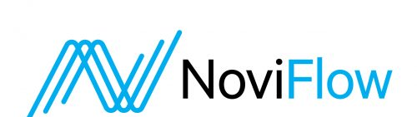
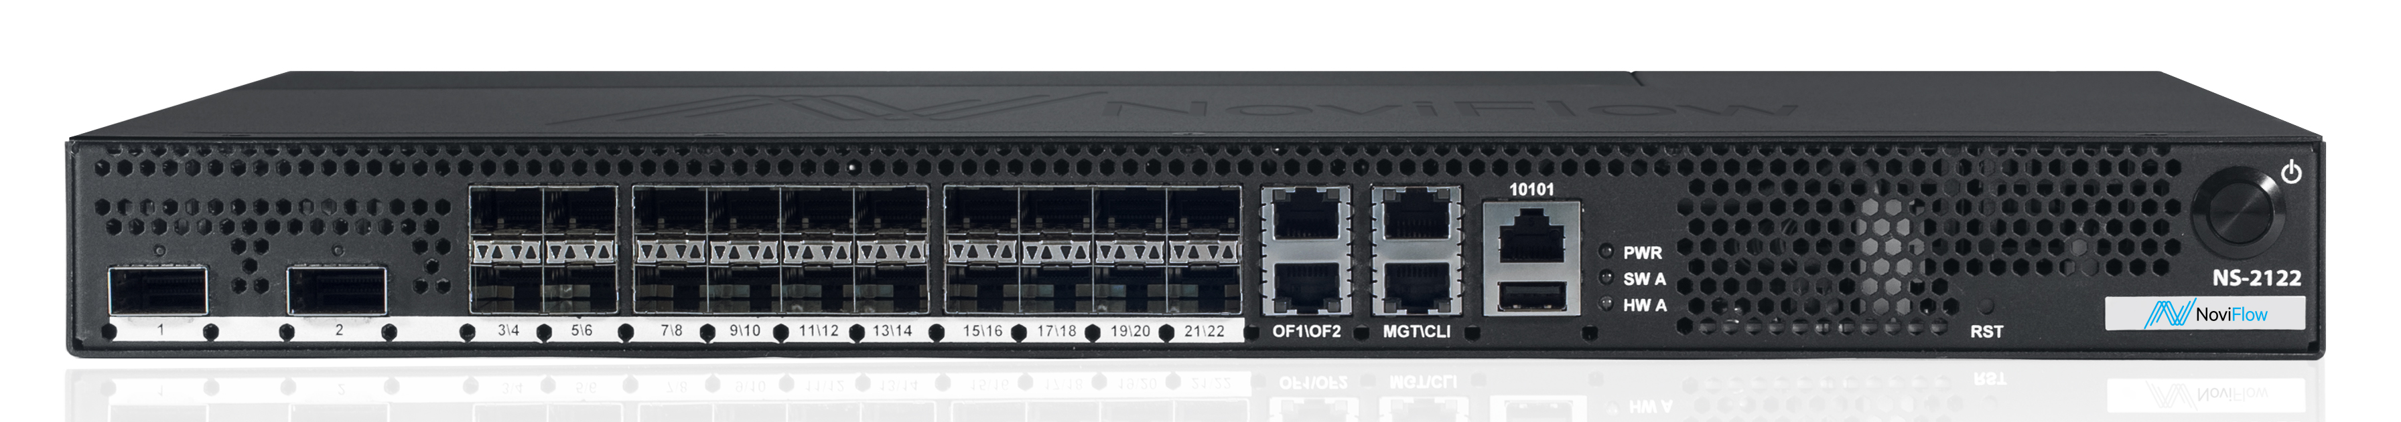
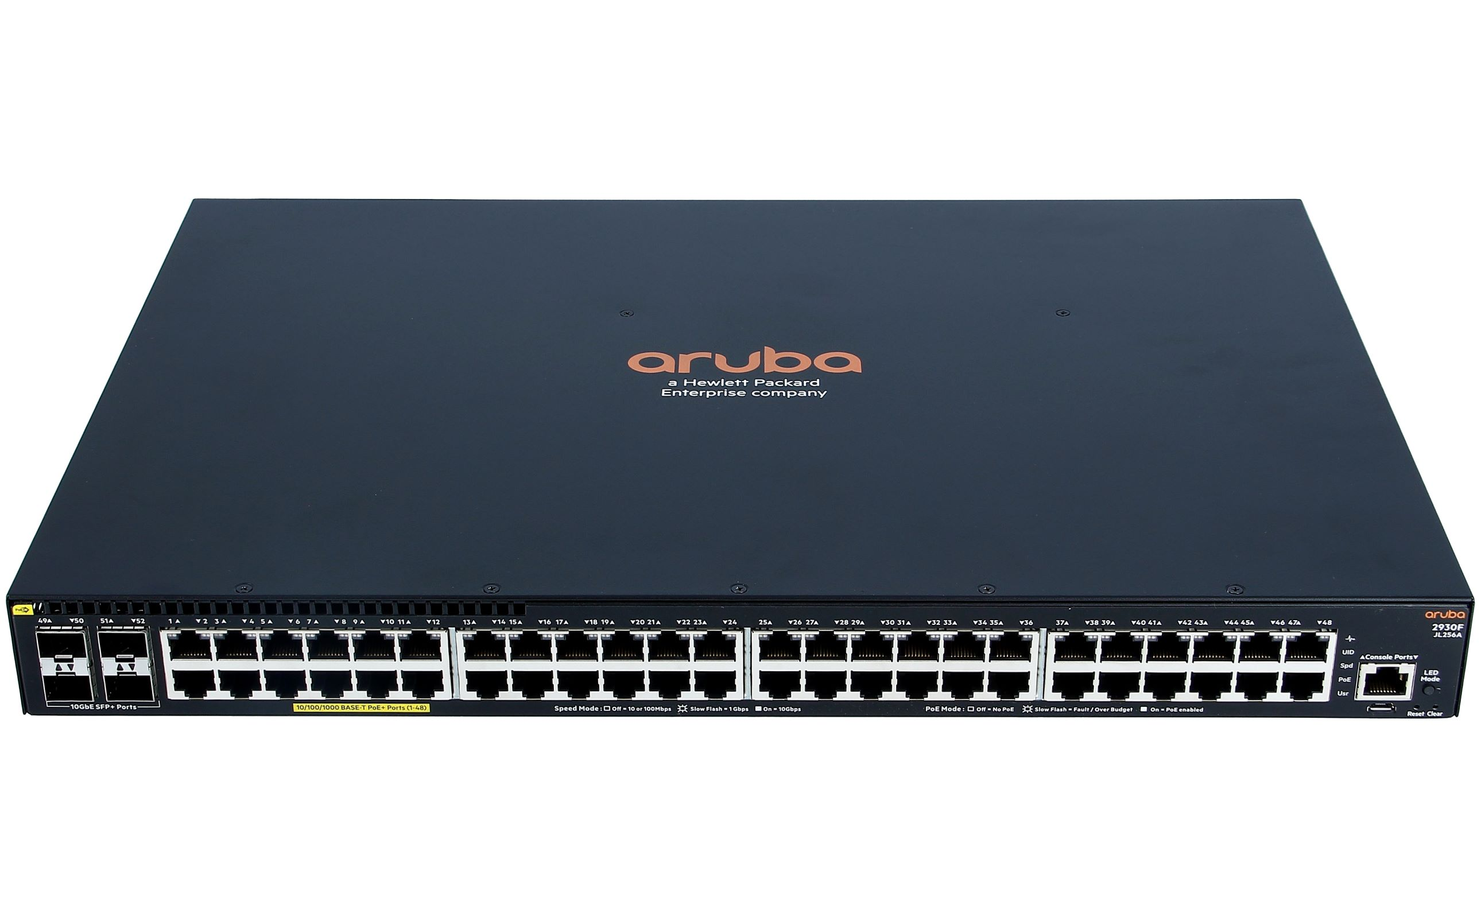
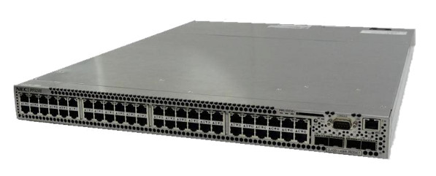
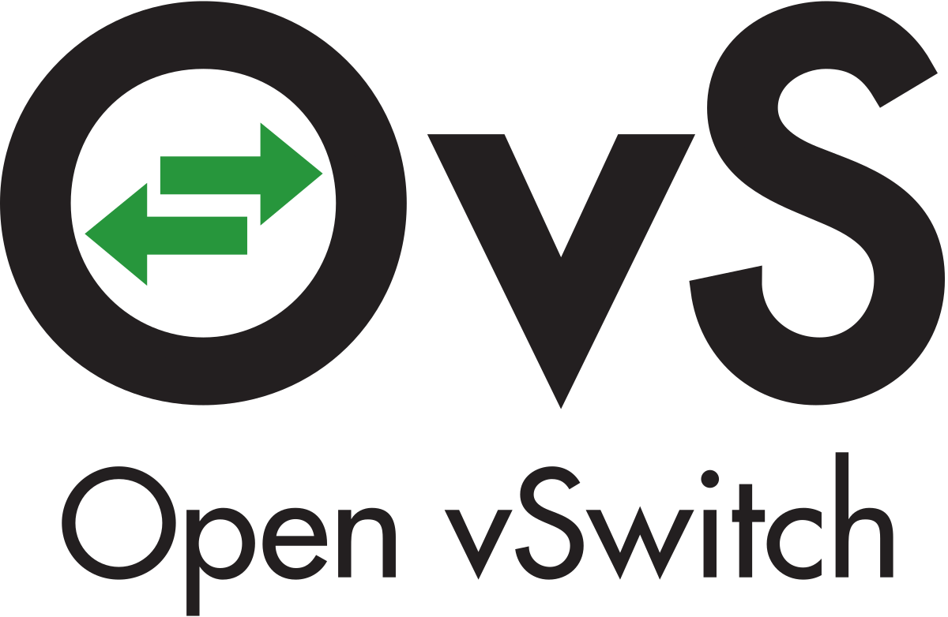

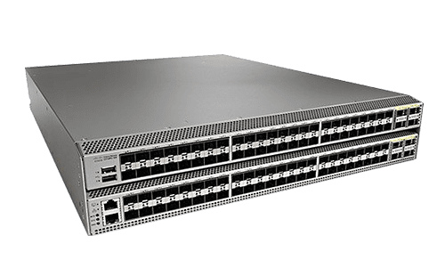
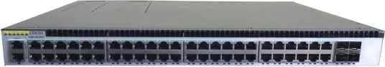

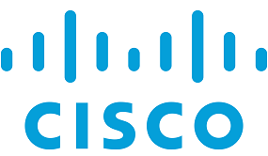
SDN Switches
Aruba 2930F Series
Cisco Nexus 9000 Series

Slide 19


Case Study: The Ryu SDN Controller
Ryu is a Python library used to develop SDN Controllers
Ryu provides a set of core libraries and scripts that implement basic functionalities of an SDN Controller:
SimpleSwitch – Decides how to forward network traffic
Ofctl_rest – A web service that provides a REST interface to retrieve information about the network topology in JSON format
Topology – Leverages Link-Layer Discovery Protocol (LLDP) to discover the network topology
In the SDN-microSENSE project, a Horizon 2020 program funded by EU, we use Apache Zookeeper to provide fault tolerance to the SDN Controller

Slide 20
The Ryu architecture
The ryu-manager process ‘runs’ multiple python scripts as independent network apps
Ryu is event driven → Ofp controller is the core app which generates events
RyuApps listen and act on events (e.g. link dropped, new incoming frame forwarded by a switch, disconnection of an SDN switch)

Slide 21
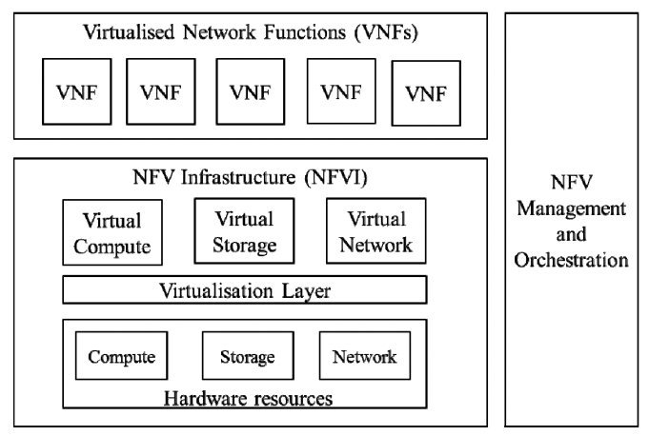
Network Function Virtualization (NFV)
NFV is the decoupling of network functions from proprietary hardware appliances and running them as software in virtual machines (or containers)
Various networks functions, like firewalls, traffic control and routing, are called virtual network functions (VNFs)
The European Telecommunications Standards Institute (ETSI) defined a high-level architectural framework and design philosophy to foster the adoption of virtualization
https://www.etsi.org/deliver/etsi_gs/NFV/001_099/002/01.01.01_60/gs_NFV002v010101p.pdf

Slide 22
Objectives of NFV ^{(official)}
Improved capital efficiency compared with dedicated hardware
Commercial-off-the-shelf (COTS) hardware provides NFs through software virtualisation techniques
Hardware is abstracted and shared with multiple NFs
Scalability according to usage and flexibility for deploying VNFs in general-use hardware
Software can be easily relocated to different sites: Nearer to the customer, in central offices or datacentres
Rapid service innovation through software-based agile service deployment
CI/CD – Continuous Integration / Continuous Testing / Continuous Deployment
Improved operational efficiency resulting from common automation procedures
Reduced power usage by migrating workloads and powering down unused hardware
Standardised and open interfaces between VNFs and the infrastructure and management entities so that any of the decoupled elements can be provided by different vendors (Interoperability)

Slide 23
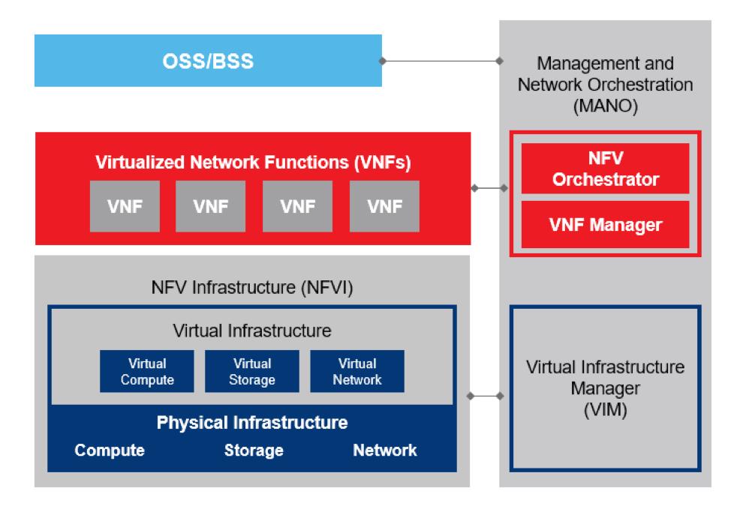
NFV Components / NFV Infrastructure
Standardized x86 computing hardware
Physical storage and network devices
Provides the virtualization layer, which abstracts hardware resources into virtual ones in order to be allocated to VNFs
Provides virtual storage and network resources
Provides the hypervisor and the management of the virtual infrastructure via the Virtual Infrastructure Manager (VIM)
https://blog.equinix.com/blog/2019/10/17/networking-for-nerds-defining-the-elements-of-nfv-architectures/

Slide 24
NFV Components / Virtual Network Functions (VNF)
Run on top of the NFVI
VNFs can be:
Virtual Routers (Cisco CSR 1000V)
Virtual Switches (Open vSwitch)
SD-WAN
Firewalls (pfSense)
QoS engines
VNFs are deployed remotely on-demand
No need for field engineers, cabling etc
Multiple VNFs can be aggregated to a single Network Service (NS)
https://blog.equinix.com/blog/2019/10/17/networking-for-nerds-defining-the-elements-of-nfv-architectures/

Slide 25
NFV Components / Network Services (NS)
VNFs connect with one another to create Network Services (NS)
NS are orchestrated by the NFV Orchestrator
An NS is comprised of the following:
Individual VNFs that implement distinct functionalities
Virtual Links: Layer 2 connections between VNFs
VNF Forwarding Graphs (VNF-FG), traffic flows between VNFs
Network Service Descriptors (NSDs) are templates (JSON or TOSCA) describing the deployment of a NS, including
Service topology (VNFs + VNF-FGs + Virtual Links)
Service characteristics, e.g. SLA
https://telcocloudbridge.com/blog/beginners-guide-to-network-service-and-vnf-forwarding-graph-in-nfv/

Slide 26
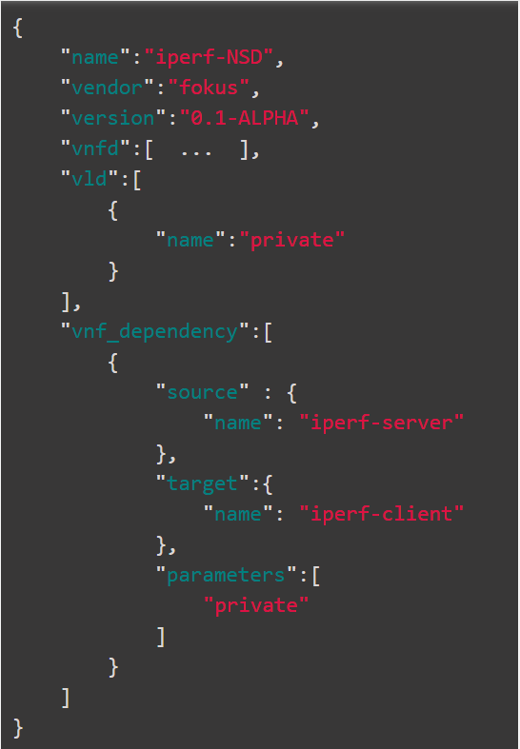
NSD Example
NS name
NS vendor
NS version
vnfd: VNFs that consist the NSD (iperf3 Server and iperf3 client – Omitted from this example)
vld: Virtual links (a single L2 broadcast domain named “private”)
vnf_dependency: (Optional) Requirements and dependencies between the VNFs
The source VNF provides information (e.g. configuration parameters) to the target VNF
https://openbaton.github.io/documentation/tutorial-docker/#iperf-nsd

Slide 27
NFV Components / NFV MANO
NFV Management and Network Orchestration (MANO) is a framework developed by ETSI to coordinate NFVI, VNFs and VMs → ETSI MANO
NFV MANO uses templates that allow admins to deploy a variety of VNFs and NS
NFV MANO is comprised of three functional areas:
NFV Orchestrator → Focuses on NS and resource orchestration
VNF Manager → Focuses on management of VNFs
Virtual Infrastructure Manager → Controls and manages the NFVI compute, storage and network resources
https://blog.equinix.com/blog/2019/10/17/networking-for-nerds-defining-the-elements-of-nfv-architectures/

Slide 28
NFV Orchestrator vs VNF Manager
NFV Orchestrator | VNF Manager
Orchestration and management of NFV infrastructure, resources and NS Resource Orchestration Service Orchestration | Management of VNFs
Onboarding of NS and VNFs, topology management of NS (VNF-FG), Instantiation - scaling in/out – termination – updating NS and VNFs, monitoring and auto-healing of VNFs (Service Orchestrator) Coordination, authorisation, release and engagement of NFVI resources amongst different or within a single Datacentre (Resource Orchestrator) | Instantiation, configuration, start/stop, scaling, updating and termination of VNFs
A single NFV Orchestrator | Multiple VNF Managers can be deployed - A single VNF manager for one or more VNFs

Slide 29
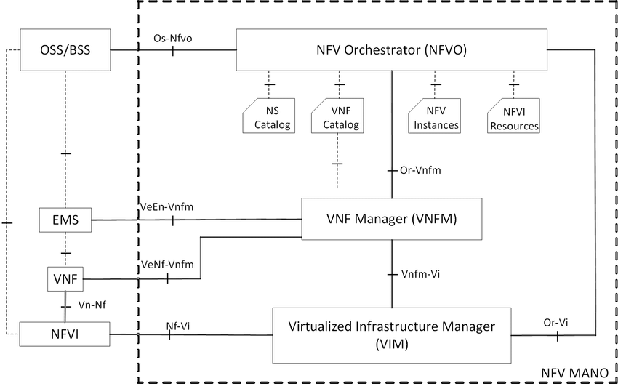
NFV MANO Components
Fundamental elements:
VNFs – Virtualised tasks
PNFs – Dedicated hardware to perform specific network functions, e.g. firewall
Virtual Deployment Unit (VDU): The VM that hosts the VNF (considered component of VNF)
Virtual Links (VL)
Network Services (NS)
VNF Forwarding Graphs (VNF-FG)
Descriptor Files: For each of the above, there is a descriptor file that describes attributes
https://www.packetflow.co.uk/what-is-etsi-mano/

Slide 30
NFV MANO Components
Repositories: Hold information in ETSI MANO
NS Catalog: A repository of all usable NSD
VNF Catalogue: A repository of all usable VNF Descriptors (VNFD)
VNF Instances: Holds information of all VNF and NS Instances
NFVI Resources – A repository of utilised NFVI resources for running VNFs or NS
https://www.packetflow.co.uk/what-is-etsi-mano/

Slide 31


Outside of MANO - OSS/BSS and EMS
Operation Support Systems / Business Support Systems (OSS/BSS)
External services that interact with the NFV MANO
OSS/BSS are utilized by Communications Service Providers (CSP)
Usable for Order Management, Billing, Customer Relationship Management, Network Inventory Management and Network Operations
Example: openslice
Element Management System (EMS)
Similar role that EMS have on physical networks
Provide FCAPS (Fault, Configuration, Accounting, Performance and Security) management
Management is applied to VNFs
One EMS per VNF or a single EMS for multiple VNFs
EMS can also be VNFs
Example: Dhyan’s Netman
https://opennetworking.org/wp-content/uploads/2014/10/sb-OSS-BSS.pdf

Slide 32
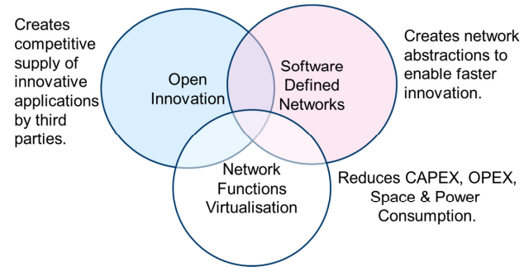
NFV vs SDN
SDN is NOT an element of the NFV architecture
However, they are both contributing to a software-centric and automated approach to network management
NFV separates hardware and software, while SDN separates control and user plane
SDN abstracts network functionalities whereas NFV abstracts network resources
SDN is NOT a mandatory or dependent technology in order to implement NFV / NFV can be implemented without SDN
However, SDN can provide added value and enhanced performance
NFV can help SDN deployments by providing the infrastructure, services and VNFs, upon which the SDN software can be run
https://portal.etsi.org/nfv/nfv_white_paper.pdf

Slide 33
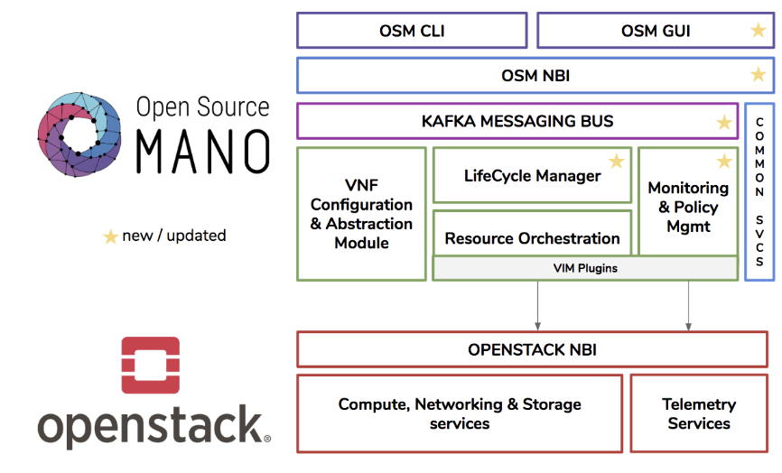
Open-Source MANO (OSM)
OSM is the “official” implementation of ETSI NFV framework, community-led and provided by ETSI
OSM is closely aligned with the evolution of ETSI NFV standard and is committed to regular updates in-line with the reference implementation of NFV MANO
Founding members: BT, Canonical, Intel, Mirantis, RIFT.io, Telefonica, ++
OSM can be integrated with Openstack as a Virtual Infrastructure Manager
https://www.openstack.org/videos/summits/vancouver-2018/achieving-end-to-end-nfv-with-openstack-and-open-source-mano

Slide 34
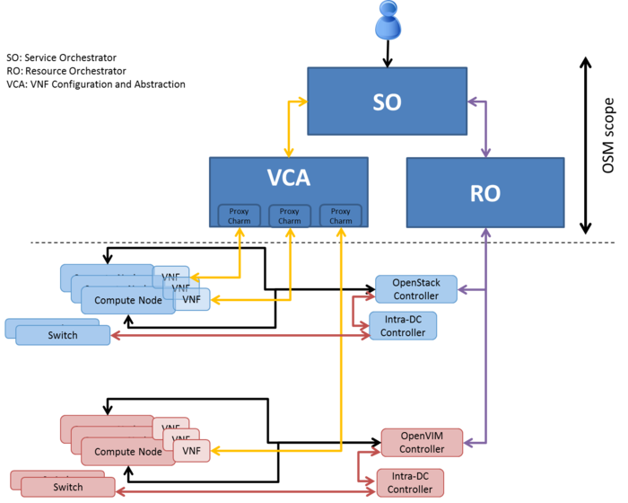
OSM Components
Service Orchestrator (SO): Based on the rift.io software, provides end-to-end service orchestration and provisioning | Most development on JavaScript and NodeJS
Resource Orchestrator (RO): Provisions resources over an IaaS provider (OpenStack, Vmware, OpenVIM) | Most development in Python
VNF Configuration and Abstraction (VCA): Performs initial configuration using Juju charms.

Slide 35
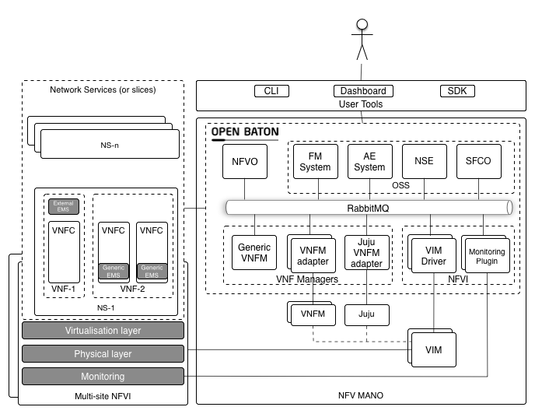
OpenBaton
Open-source implementation of a NFV MANO compliant framework, alternative to OSM
VIM plugins for Juju, Docker Engine, Docker Swarm and Kubernetes
Zabbix for network monitoring
RabbitMQ as the message bus
Other alternatives: OPEN-O, T-NOVA/TeNor, SONATA, Cloudify, MAESTRO (Ubitech)
https://openbaton.github.io/documentation/

Slide 36
Accompanying software components ^{(just examples)}
Message Bus for asynchronous message delivery between components. RabbitMQ and Apache Kafka are some of the most reliable solutions
The ELK stack can be used for data management and storage: (Elasticsearch license)
Elasticsearch for data store, runtime data and logs
Logstash performs pre-processing of logs, converting them to common formats
Kibana can be used for visualisations of Elasticsearch data
Prometheus is an alternative to Elastisearch for time-series data and Grafana alternative to Kibana for visualisations (Apache 2.0 license)
Riemann.io can be used as policy engine to process runtime decisions about availability, SLA and overall monitoring
Kubernetes for orchestration and scaling of docker containers
Keycloak or WSO2 can be used as identity server, providing authorisation, authentication and accounting for VNFs and users
https://www.mirantis.com/blog/which-nfv-orchestration-platform-best-review-osm-open-o-cord-cloudify/

Slide 37
NFV, SDN and 5G
5G relies on NFV to implement a compliant and standard-based mobile network architecture that is based on virtualisation
SDN provides additional capabilities of automation and QoS assurance
Specialised VNFs (e.g. mobility management VNF or Slicing Management VNF) are developed to satisfy specific functional requirements of 5G
5G software is abstracted and can run in common x86 hardware, on the cloud or on the edge
Development of innovative services is ensured by adopting common open-source tools and common interfaces → Focus is now given on intelligence

Slide 38
5G Research and OSM
Numerous research projects in EU leverage OSM to implement NFV MANO for 5G implementations. Research is oriented into providing new features to OSM and satisfying new emerging use cases
Metro-Haul → Aims to provide a smart optical metro infrastructure that supports traffic originating from heterogenous 5G access networks → Contributed to the WAN Infrastructure Management (OSM release 5)
Matilda → Holistic 5G end-to-end services operational framework, tackling the life cycle of design, development and orchestration of 5G-ready applications and network services.
5G-Tango → Incorporates flexible programmability of 5G networks by collaborating with different open-source initiatives to accelerate the NFV uptake in industry
5G-City → Provides a distributed cloud and radio platform for municipalities and infrastructure owners acting as 5G neutral hosts
5G-Media → Provides an orchestration and DevOps platform for network media services and applications running on 5G networks
5G-Transformer → Aims to bring network slicing into mobile transport networks tailored to verticals
https://superuser.openstack.org/articles/5g-projects-building-strong-use-cases-for-open-source-mano-nfv/

Slide 39
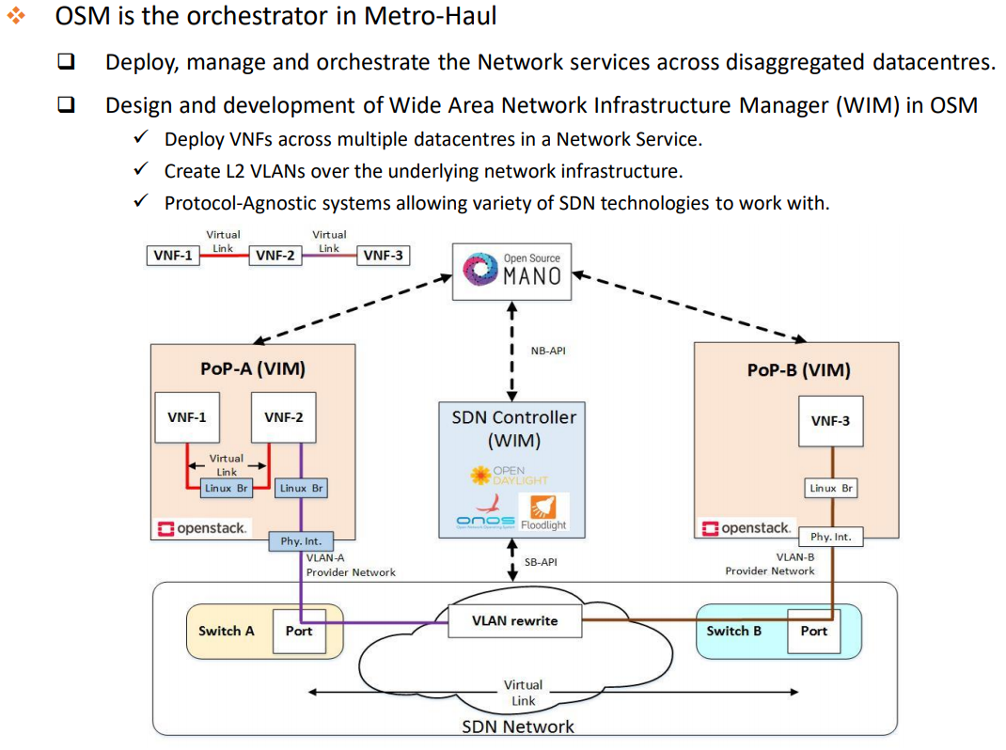

Slide 40
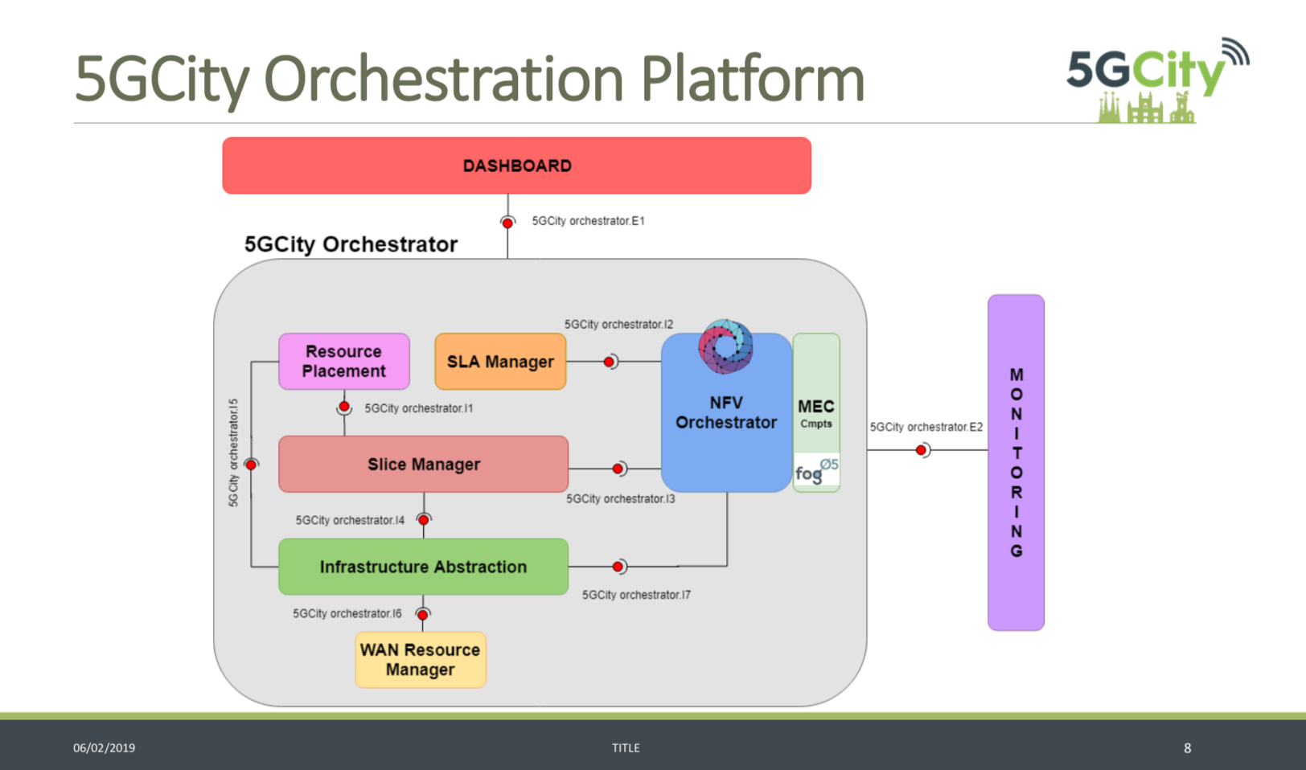

Slide 41
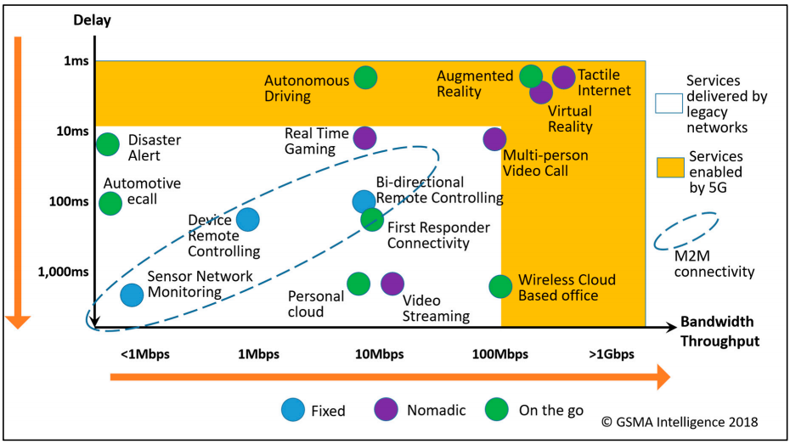
https://www.gsma.com/futurenetworks/wp-content/uploads/2015/01/2014-12-08-c88a32b3c59a11944a9c4e544fee7770.pdf

